Slide 1
EMPLOYEE ATTRITION

Slide 2
INTRODUCTION
XYZ Company has been facing a concerning attrition rate of around 15% over the past few years, significantly impacting various aspects of its operations. High employee turnover can lead to increased recruitment costs, loss of valuable knowledge, and decreased morale among remaining employees. To address this issue, XYZ Company has sought the expertise of an HR analytics consultancy to analyze employee data and uncover the underlying factors contributing to attrition. By understanding these factors, the company aims to implement targeted strategies to reduce turnover and retain valuable talent.
In this project, I am taking on the role of an HR analyst to thoroughly investigate the employee attrition patterns at XYZ Company. Using a dataset containing detailed information about employees, including their demographics, job roles, and work experiences, I will conduct a comprehensive analysis to identify key drivers of attrition. The findings from this analysis will be used to create a data-driven dashboard, providing the organization with actionable insights to improve employee retention and foster a more stable and satisfied workforce.

Slide 3
OBJECTIVE
The objective of this project is to analyze employee data to identify key factors contributing to the high attrition rate at XYZ Company, and to provide actionable insights and recommendations that will help the company reduce turnover and improve employee retention.

Slide 4
MAIN KPIs
Overall Attrition Rate
Attrition Rate by Department
Attrition Rate by Job Role
Attrition Rate by Age Group
Attrition Rate by Gender
Average Tenure of Employees
Job Satisfaction Score
Environment Satisfaction Score
Attrition Rate
Employee Satisfaction
Average Monthly Income
Job Role Attrition Rate

Slide 5
POWER BI DASHBOARD
The dashboard will allow users to explore these metrics in detail, compare attrition rates across different segments, and derive actionable insights to help XYZ Company reduce its attrition rate and enhance overall employee satisfaction.

Slide 6
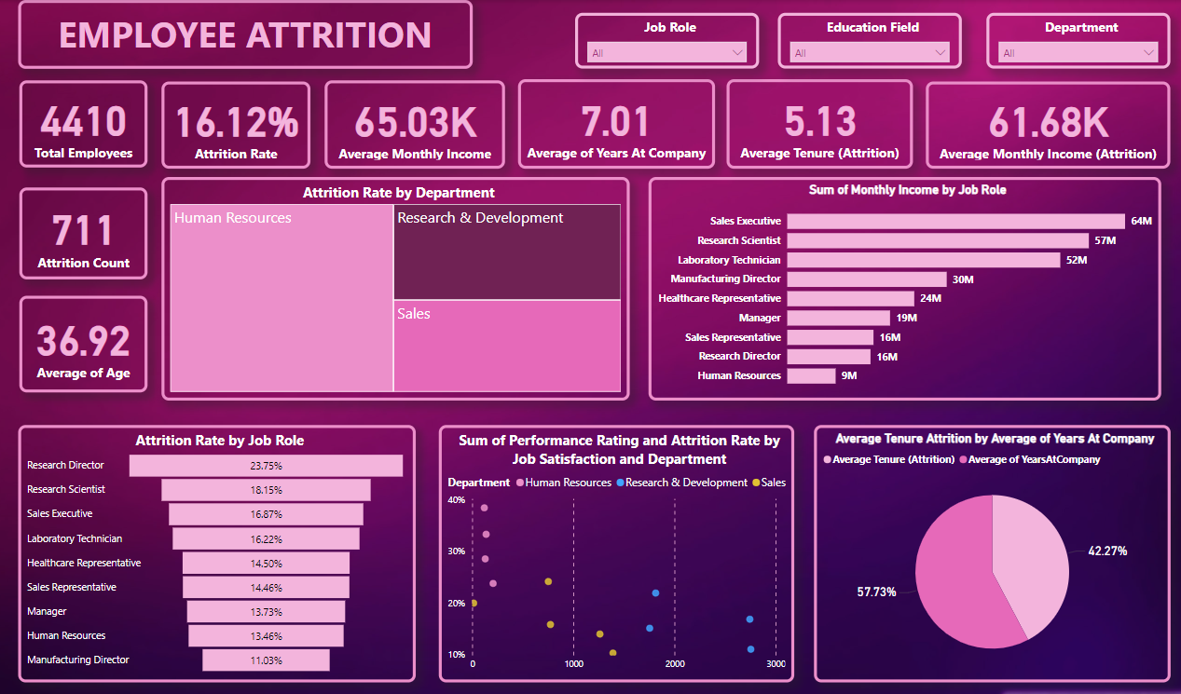

Slide 7
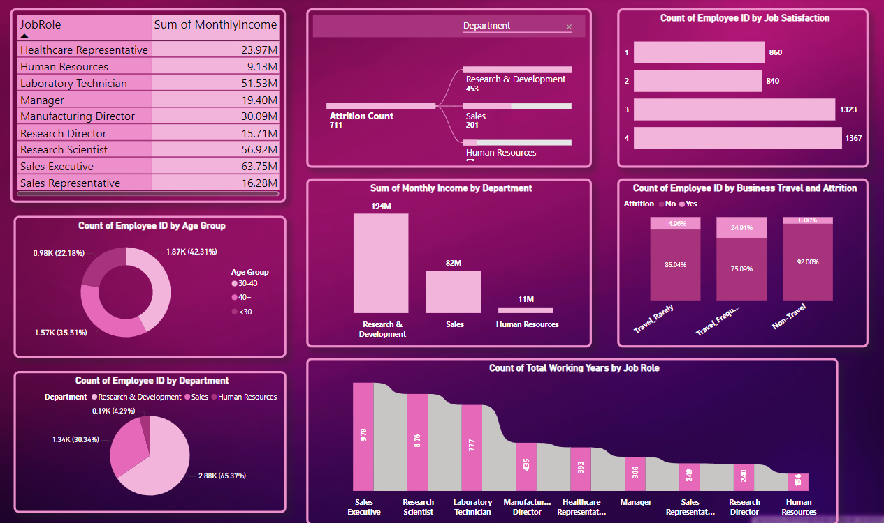

Slide 8
MY SQL
The analysis will provide XYZ Company with insights into the main drivers of employee attrition and recommend strategies to enhance employee retention, thereby improving overall organizational stability and performance.

Slide 9
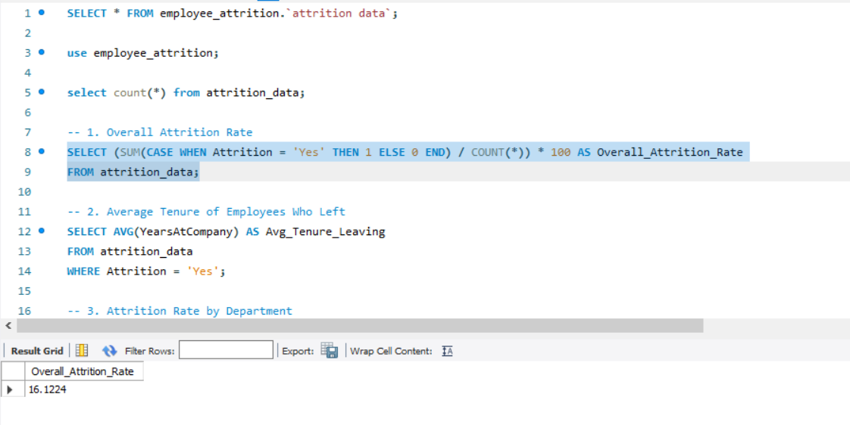

Slide 10
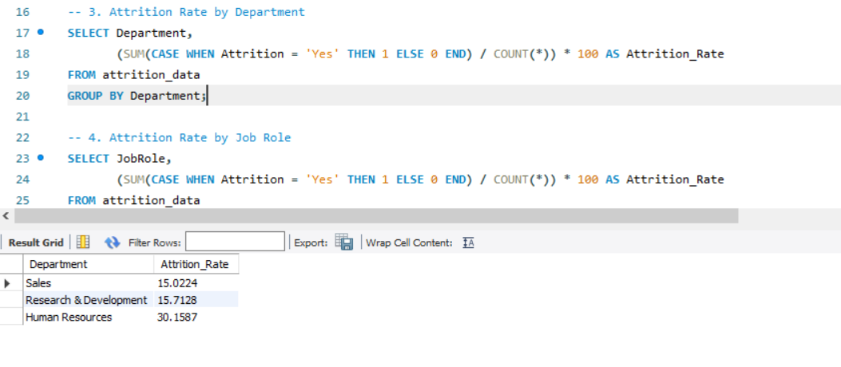

Slide 11
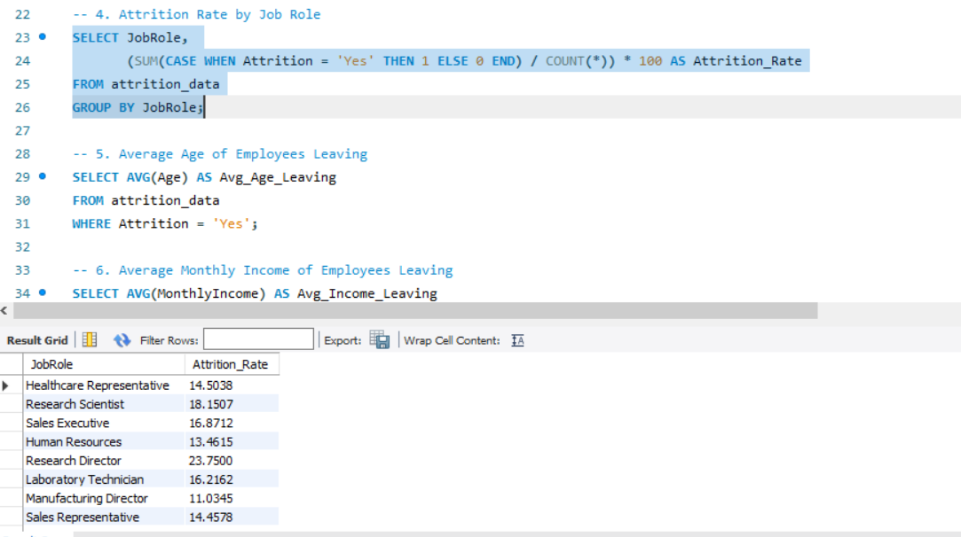

Slide 12
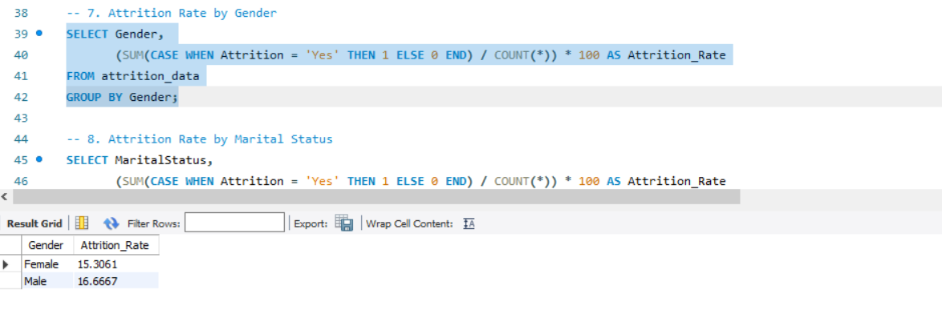

Slide 13
PYTHON
The Python-based approach ensures a thorough, data-driven examination of the factors influencing employee turnover, enabling XYZ Company to make informed decisions to enhance employee satisfaction and organizational stability.

Slide 14
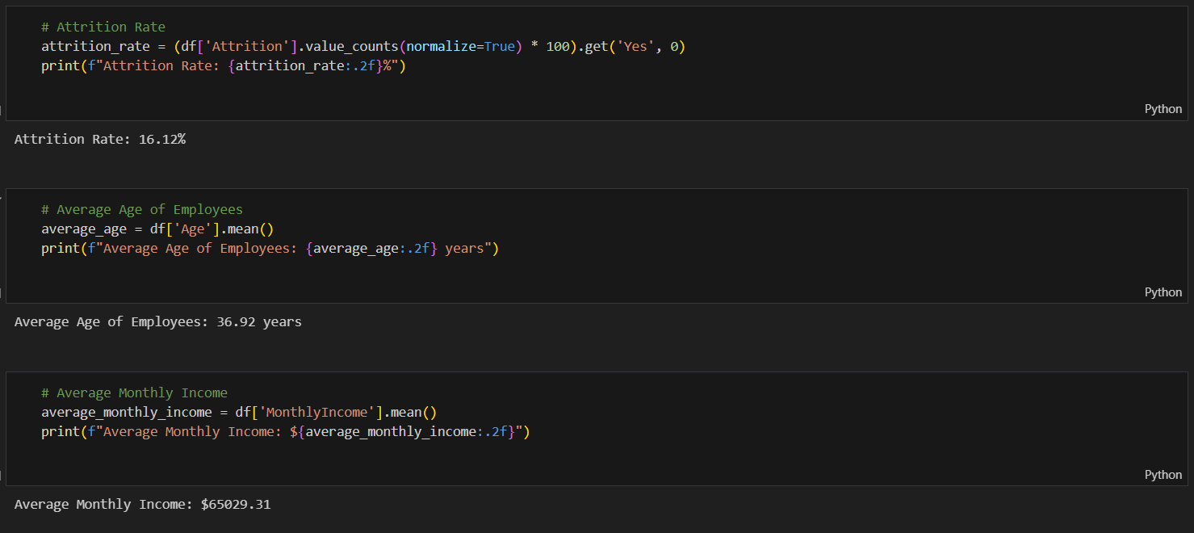

Slide 15
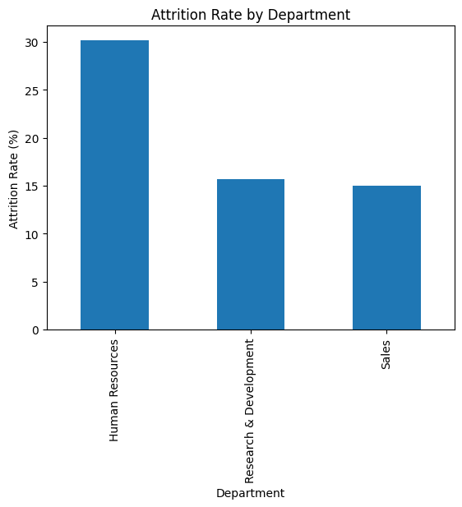

Slide 16
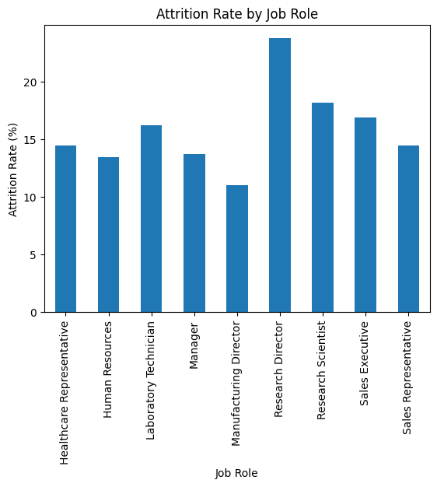

Slide 17
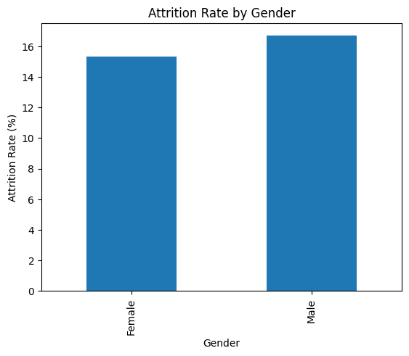

Slide 18
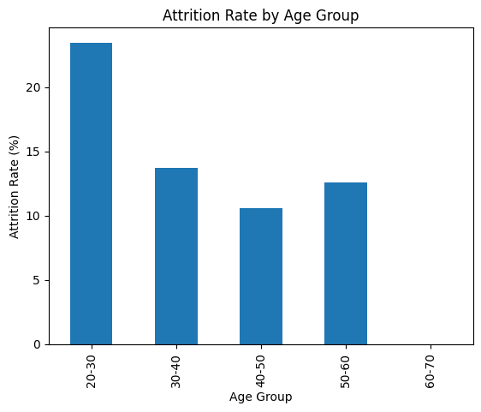

Slide 19
CONCLUSION
The analysis of XYZ Company's employee data has provided valuable insights into the factors contributing to the organization's 15% attrition rate. Key findings indicate that factors such as job role, department, business travel frequency, distance from home, and years since last promotion significantly influence employee turnover. Additionally, aspects like job involvement, work-life balance, and satisfaction levels play a crucial role in employee retention.
By addressing these factors through targeted interventions, XYZ Company can reduce its attrition rate and foster a more engaged and satisfied workforce. Implementing strategies such as improving work-life balance, offering career growth opportunities, and enhancing employee satisfaction across various departments will be vital in retaining top talent.
The interactive dashboard created as part of this project will enable XYZ Company to continuously monitor these key indicators and make data-driven decisions aimed at reducing attrition. By leveraging these insights, the company can not only lower turnover rates but also enhance overall organizational performance and employee well-being.

Slide 20


VISIT FOR DETAILED PROJECT
Click on linkedin logo to visit my Profile
Click on Github logo to visit the portfolio of the project

